Slide 1
Multi-arm Bandits
Sutton and Barto, Chapter 2
The simplest reinforcement learning problem

Slide 2


You are the algorithm! (bandit1)
Action 1 — Reward is always 8
value of action 1 is
Action 2 — 88% chance of 0, 12% chance of 100!
value of action 2 is
Action 3 — Randomly between -10 and 35, equiprobable
Action 4 — a third 0, a third 20, and a third from {8,9,…, 18}
-10
0
35
0
20

Slide 3
The k-armed Bandit Problem
On each of an infinite sequence of time steps, t=1, 2, 3, …, you choose an action At from k possibilities, and receive a real-valued reward Rt
The reward depends only on the action taken; it is indentically, independently distributed (i.i.d.):
These true values are unknown. The distribution is unknown
Nevertheless, you must maximize your total reward
You must both try actions to learn their values (explore), and prefer those that appear best (exploit)
true values

Slide 4




The Exploration/Exploitation Dilemma
Suppose you form estimates
Define the greedy action at time t as
If then you are exploiting If then you are exploring
You can’t do both, but you need to do both
You can never stop exploring, but maybe you should explore less with time. Or maybe not.
action-value estimates

Slide 5
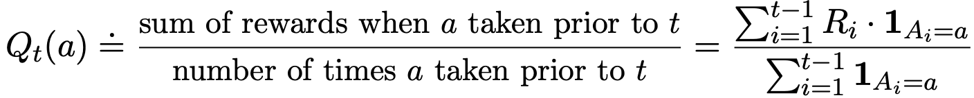

Action-Value Methods
Methods that learn action-value estimates and nothing else
For example, estimate action values as sample averages:
The sample-average estimates converge to the true values If the action is taken an infinite number of times
The number of times action a
has been taken by time t

Slide 6
ε-Greedy Action Selection
In greedy action selection, you always exploit
In 𝜀-greedy, you are usually greedy, but with probability 𝜀 you instead pick an action at random (possibly the greedy action again)
This is perhaps the simplest way to balance exploration and exploitation

Slide 7
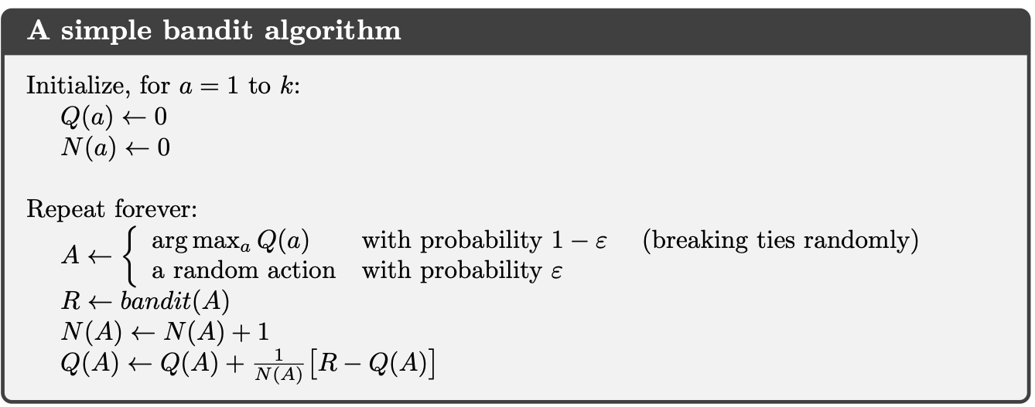

Slide 8
Bandits: What we learned so far
Multi-armed bandits are a simplification of the real problem
they have action and reward (a goal), but no input or sequentiality
A fundamental exploitation-exploration tradeoff arises in bandits
𝜀-greedy action selection is the simplest way of trading off
Learning action values is a key part of solution methods
The 10-armed testbed illustrates all

Slide 9
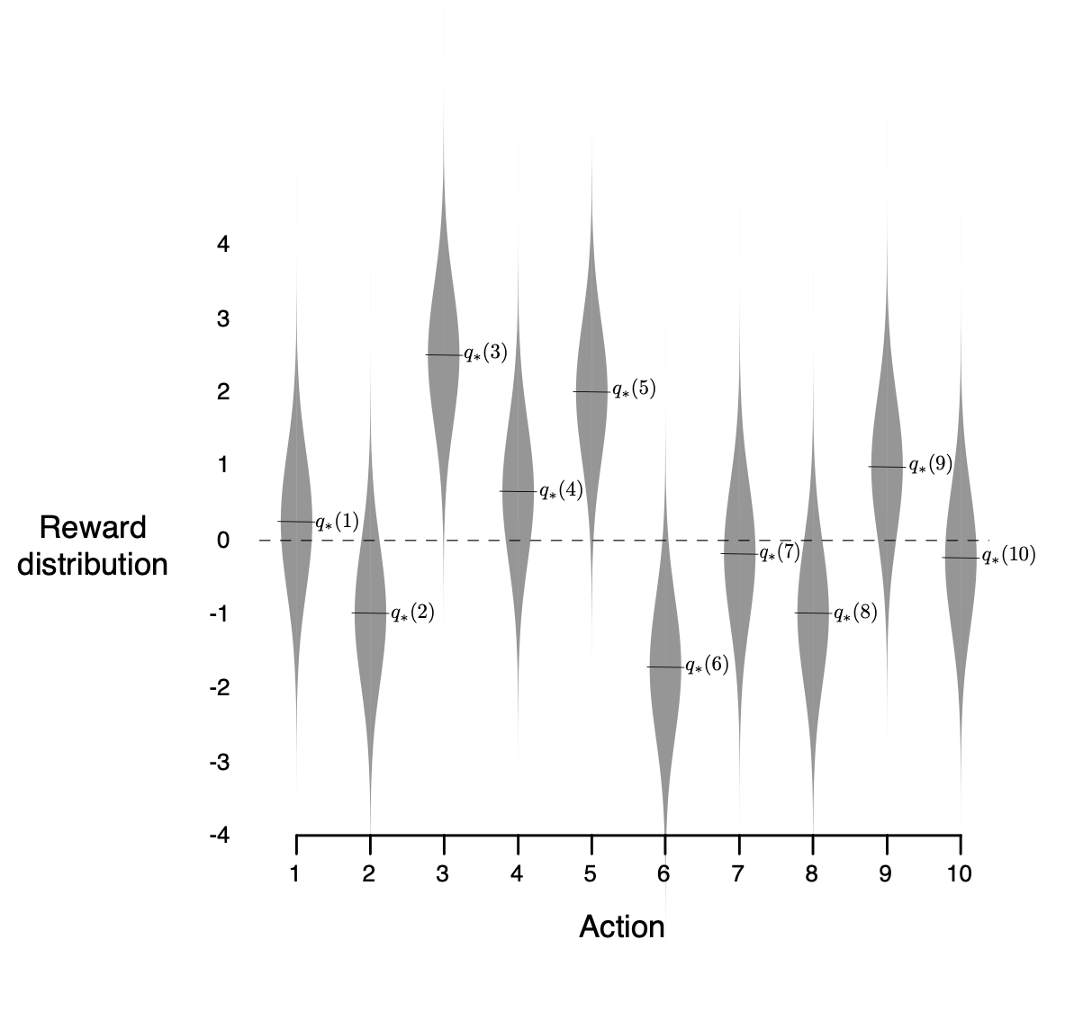


One Bandit Task from The 10-armed Testbed
Run for 1000 steps
Repeat the whole
thing 2000 times
with different bandit
tasks

Slide 10
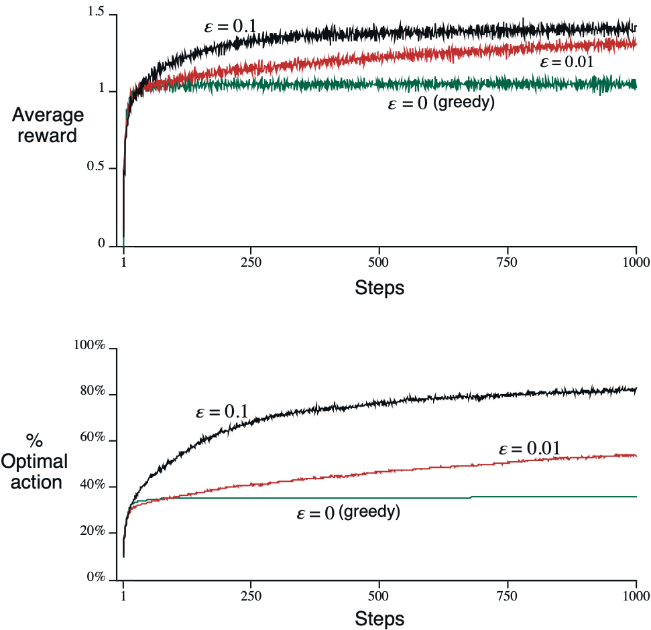
ε-Greedy Methods on the 10-Armed Testbed

Slide 11
Bandits: What we learned so far
Multi-armed bandits are a simplification of the real problem
they have action and reward (a goal), but no input or sequentiality
The exploitation-exploration tradeoff arises in bandits
𝜀-greedy action selection is the simplest way of trading off
Learning action values is a key part of solution methods
The 10-armed testbed illustrates all
Learning as averaging – a fundamental learning rule

Slide 12
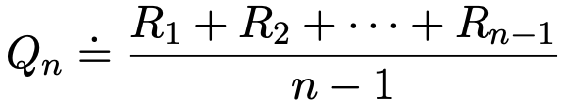
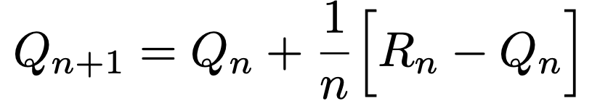
Averaging ⟶ learning rule
To simplify notation, let us focus on one action
We consider only its rewards, and its estimate after n+1 rewards:
How can we do this incrementally (without storing all the rewards)?
Could store a running sum and count (and divide), or equivalently:
This is a standard form for learning/update rules:

Slide 13
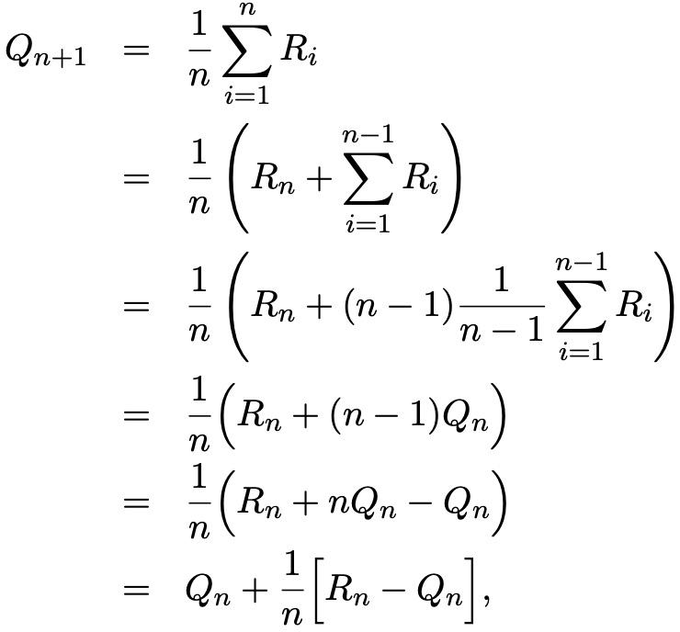
Derivation of incremental update

Slide 14
Averaging ⟶ learning rule
To simplify notation, let us focus on one action
We consider only its rewards, and its estimate after n+1 rewards:
How can we do this incrementally (without storing all the rewards)?
Could store a running sum and count (and divide), or equivalently:
This is a standard form for learning/update rules:

Slide 15
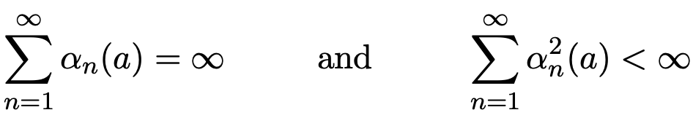
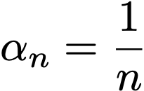

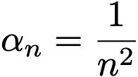

Standard stochastic approximation convergence conditions
To assure convergence with probability 1:
e.g.,
not
.
if
.
.
then convergence is at the optimal rate:

Slide 16
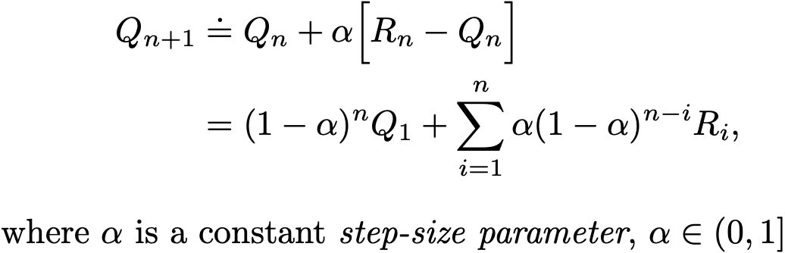

Tracking a Non-stationary Problem
Suppose the true action values change slowly over time
then we say that the problem is nonstationary
In this case, sample averages are not a good idea (Why?)
Better is an “exponential, recency-weighted average”:
There is bias due to that becomes smaller over time

Slide 17




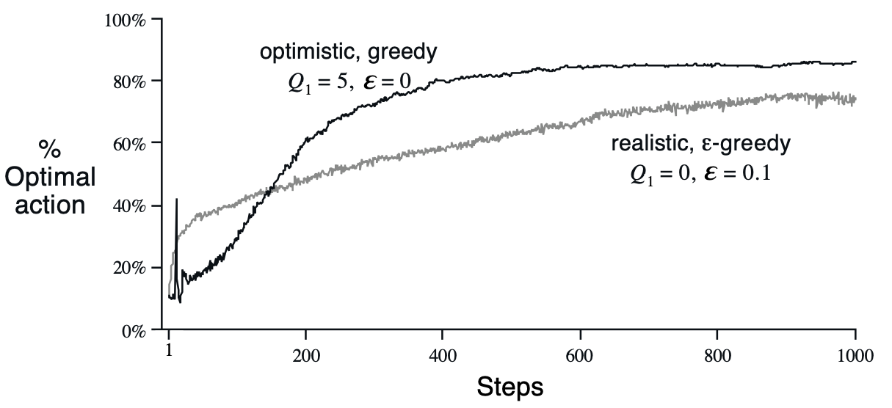
Optimistic Initial Values
All methods so far depend on , i.e., they are biased. So far we have used
Suppose we initialize the action values optimistically ( ), e.g., on the 10-armed testbed (with )

Slide 18
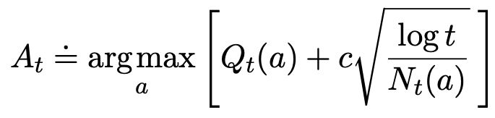
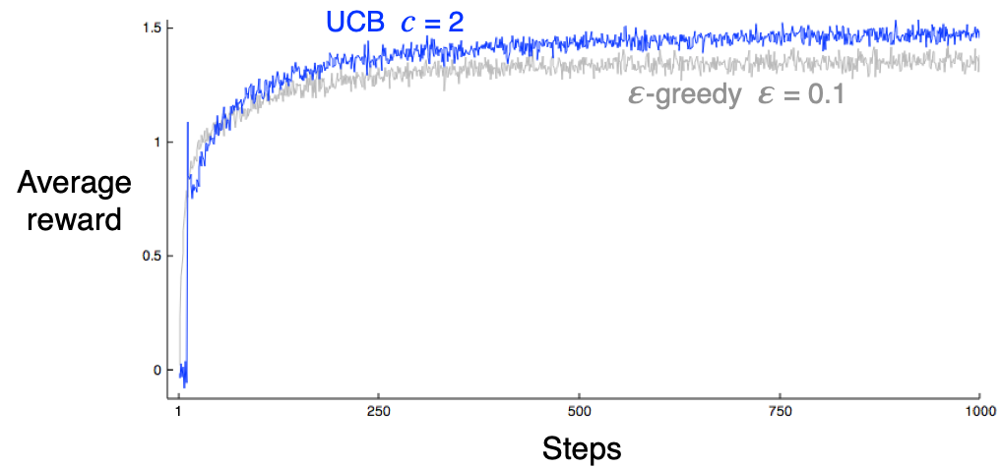
Upper Confidence Bound (UCB) action selection
A clever way of reducing exploration over time
Estimate an upper bound on the true action values
Select the action with the largest (estimated) upper bound

Slide 19

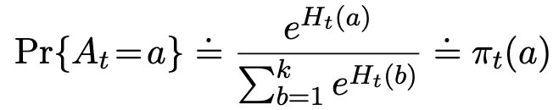
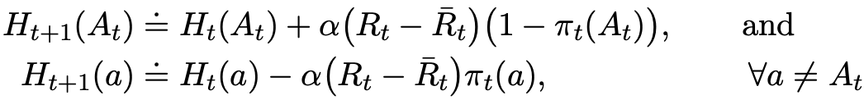
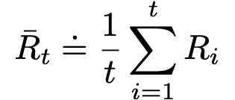
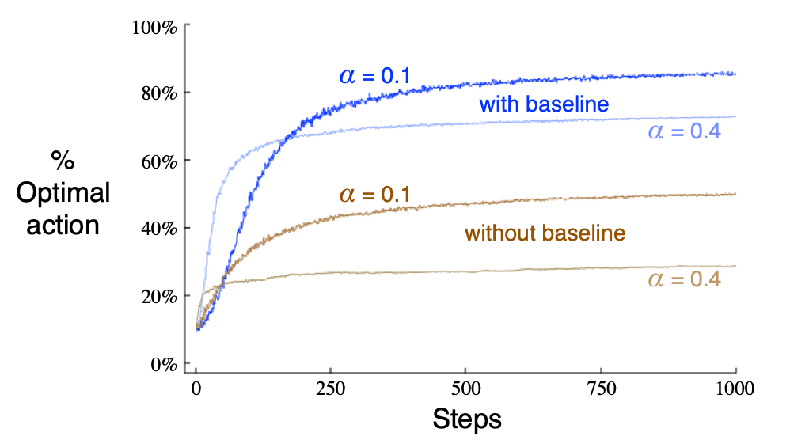
Gradient-Bandit Algorithms
Let be a learned preference for taking action a
Notes:
What if the problem is non-stationary?

Slide 20

Gradient-Bandit Algorithms
Let be a learned preference for taking action a
Notes:
What if the problem is non-stationary?

Slide 21
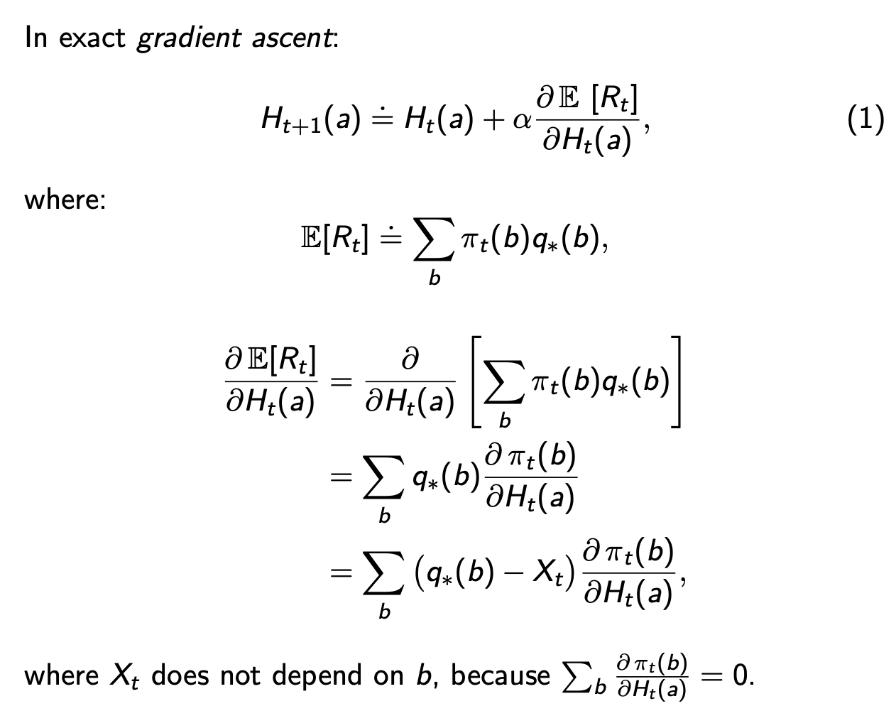
Derivation of gradient-bandit algorithm

Slide 22
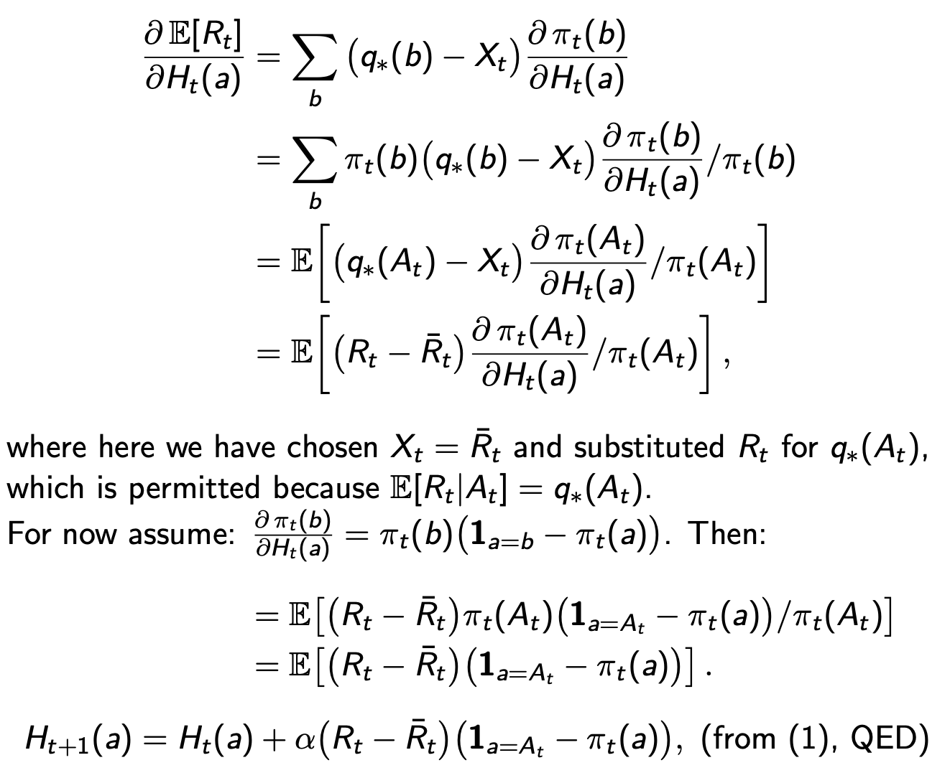

Slide 23
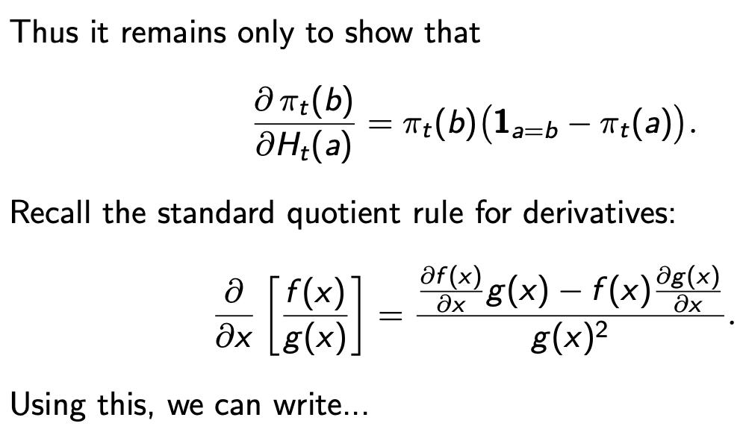

Slide 24
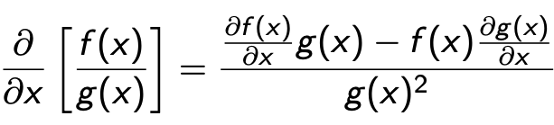
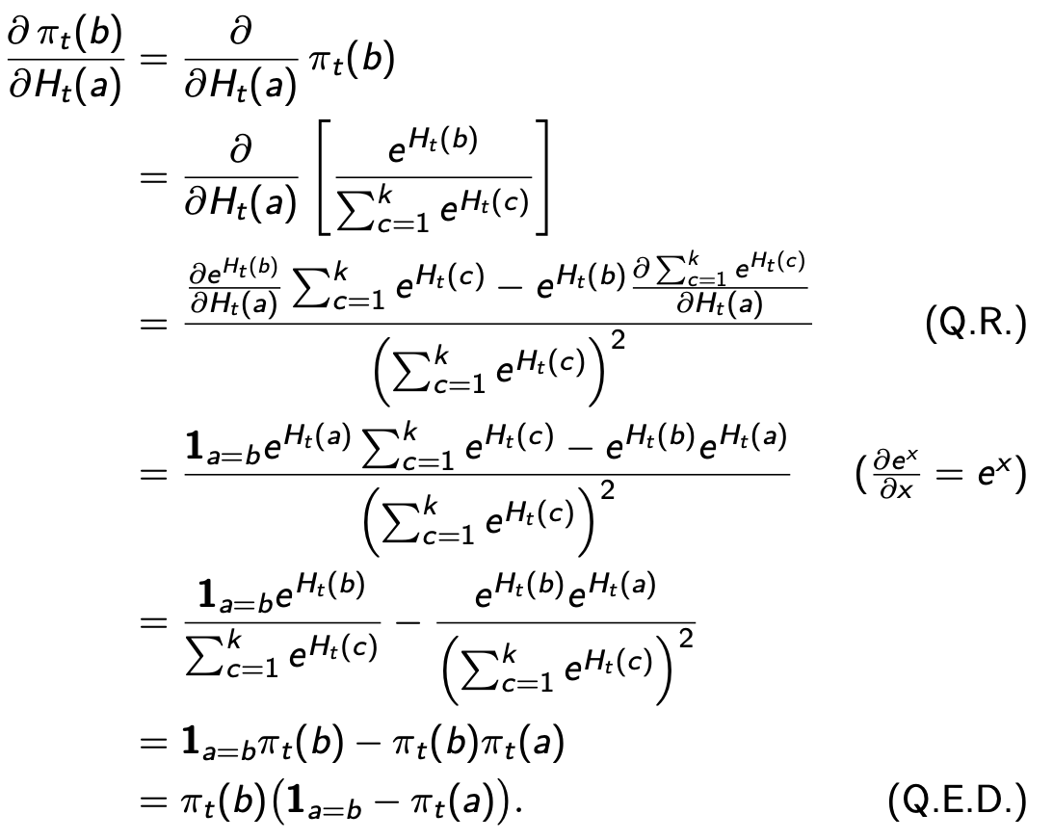
Quotient Rule:

Slide 25
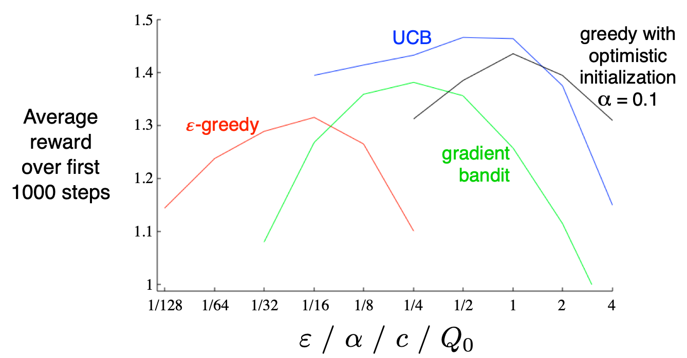
Summary Comparison of Bandit Algorithms

Slide 26
Conclusions
These are all simple methods
but they are complicated enough—we will build on them
we should understand them completely
there are still open questions
Our first algorithms that learn from evaluative feedback
and thus must balance exploration and exploitation
Our first algorithms that appear to have a goal —that learn to maximize reward by trial and error

Slide 27
Our first dimensions!
Problems vs Solution Methods
Evaluative vs Instructive
Associative vs Non-associative
Bandits?
Problem or Solution?

Slide 28
Problem space
 | Single State | Associative
Instructive feedback
Evaluative feedback

Slide 29
Problem space
 | Single State | Associative
Instructive feedback
Evaluative feedback | Bandits (Function optimization)

Slide 30
Problem space
 | Single State | Associative
Instructive feedback |  | Supervised learning
Evaluative feedback | Bandits (Function optimization)

Slide 31
Problem space
 | Single State | Associative
Instructive feedback | Averaging | Supervised learning
Evaluative feedback | Bandits (Function optimization)

Slide 32
Problem space
 | Single State | Associative
Instructive feedback | Averaging | Supervised learning
Evaluative feedback | Bandits (Function optimization) | Associative Search (Contextual bandits)

